Slide 1
History does not repeat itself, but it often rhymes Mark twain

Slide 2
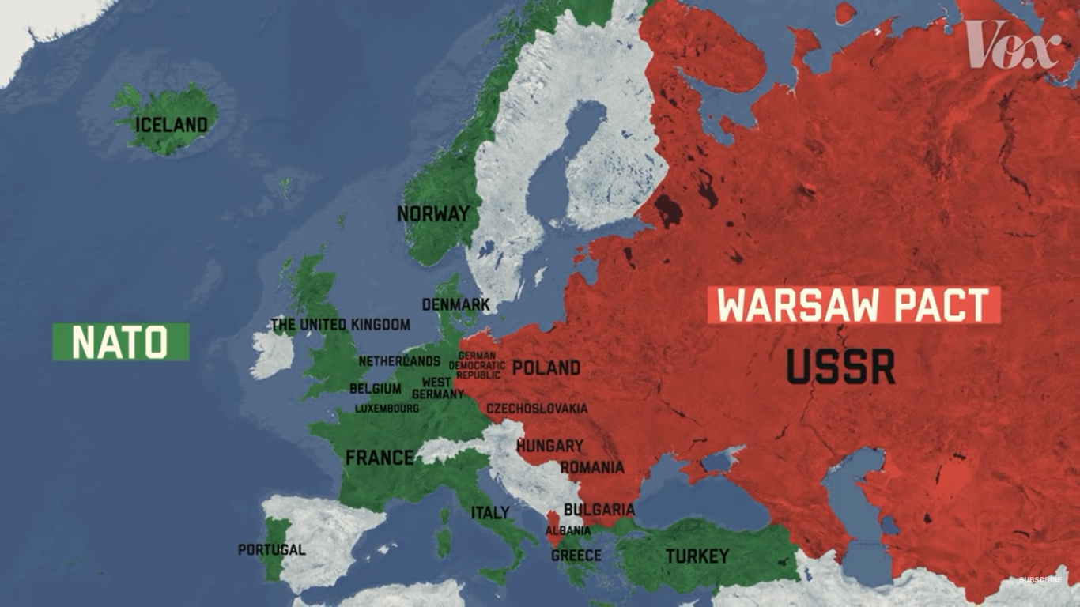

Slide 3
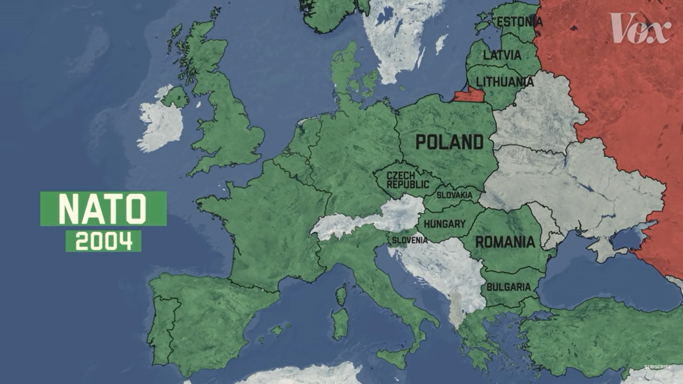

Slide 4
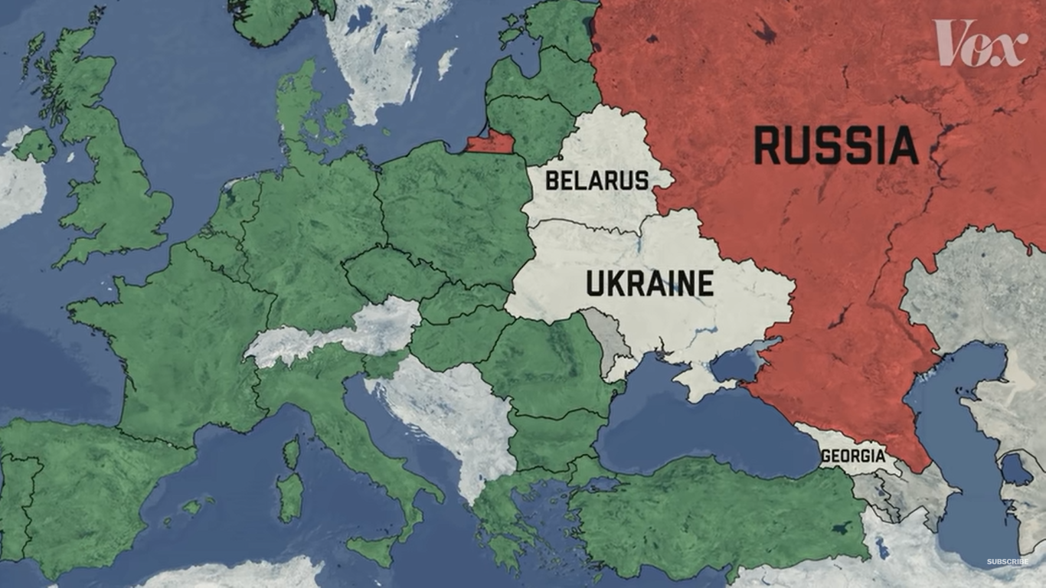

Slide 5
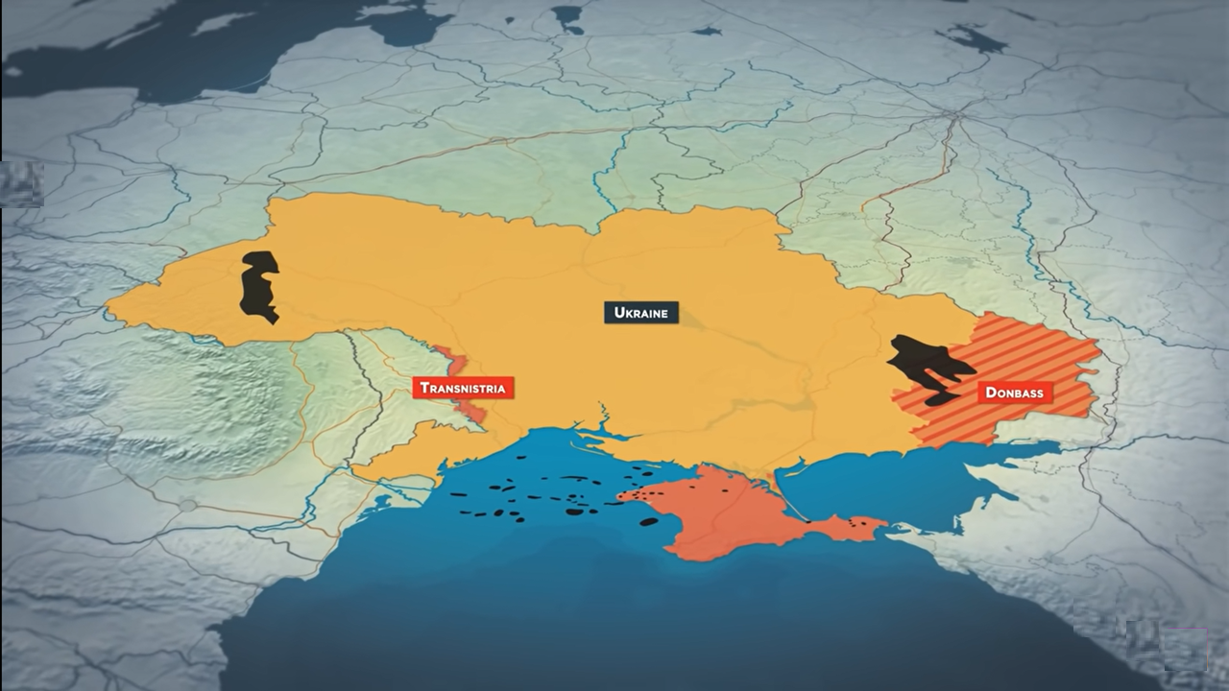
Ukraine found Shale and natural gas deposits which could make it the 14th largest natural gas producer and the second producer in Europe

Slide 6
The Actors and What they want
Western Bloc (USA/NATO/EU)
Russia
Expanded influence of NATO
Increased influence of democracy
Avoid humanitarian crisis
Support for a sovereign country to defend itself
Decreased Russian sphere of influence
Freeze NATO and restore NATO troops to pre warsaw pact lines
Autonomy for Russian speaking areas (Donbas/Luhansk)
Political Sway in Ukraine
Save Expenses on Gas Pipeline System
Avoid competitor in key sector of economy where 30% of GDP comes from Oil and NG
Force Ukraine to spend more money on defence rather than oil and natural gas
Restore USSR and expand east before the ageing population becomes a risk
Ukraine
Split demographically (Eu Membership/NATO)
Wants to use its Natural resources effectively
Wants to restore territorial Integrity (Crimea etc)
Needs support from EU and NATO members to defend it self and its assets
Desire to join EU and NATO

Slide 7
Solutions
Military Force
Direct involvement from NATO or other European nations could lead to an escalated war
Russia could respond with increased reliance on airpower and nuclear arsenal
Europe reducing investing in military.
Economic Sanctions
North korea still keeps nuclear weapons
Iran continues to sell its oil
Venezuela and Syria are still run by dictators from a US point of view
Found other ways for oil/gas transfer given global demand
Countries looking for alternatives to dollar as reserve currency
Russia already stress tested economy for possible shocks to their financial systems
Diplomacy
Support for Ukraine in “democratic countries “ not yielding necessary results
International pressure not creating bipolar world as expected. It’s a Multipolar world

